Slide 1
Shiny-2

Slide 2
.
.
.
Graphics
User feedback
Uploads and downloads
Dynamic UI
Updating inputs
Simple uses
Hierarchical select boxes
Inter-related inputs
Dynamic visibility
Conditional UI
Creating UI with code
Multiple controls
Dynamic filtering
Tidy evaluation
Data-masking
Indirection
Example: ggplot2
Example: dplyr
User supplied data
Tidy-selection
.
.
.
Graphics
User feedback
Validation
Validating input
Pausing execution with req()
req() and validation
Validate output
Notifications
Progress bars
Confirming and undoing
Uploads and downloads
Upload
UI & Server
Uploading data
Download
Basics
Downloading data
Downloading reports
Case study

Slide 3
5)User feedback
You can often make your app more usable by giving the user more insight into what is happening. This might take the form of better messages when inputs don’t make sense, or progress bars for operations that take a long time. Some feedback occurs naturally through outputs, which you already know how to use, but you’ll often need something else.

Slide 4
5.1) Validation
The first and most important feedback you can give to the user is that they’ve given you bad input. This analogous to writing good functions in R: user-friendly functions give clear error message describing what the expected input is and how you have violated those expectations. Thinking through how the user might misuse your app allows you to provide informative messages in the UI, rather than allowing errors to trickle through into the R code and generate uninformative errors.
A great way to give additional feedback to the user is via the shinyFeedback package. Using it is a two step process. First, you add useShinyFeedback() to the ui. This sets up the needed HTML and javascript for attractive error message display:

Slide 5
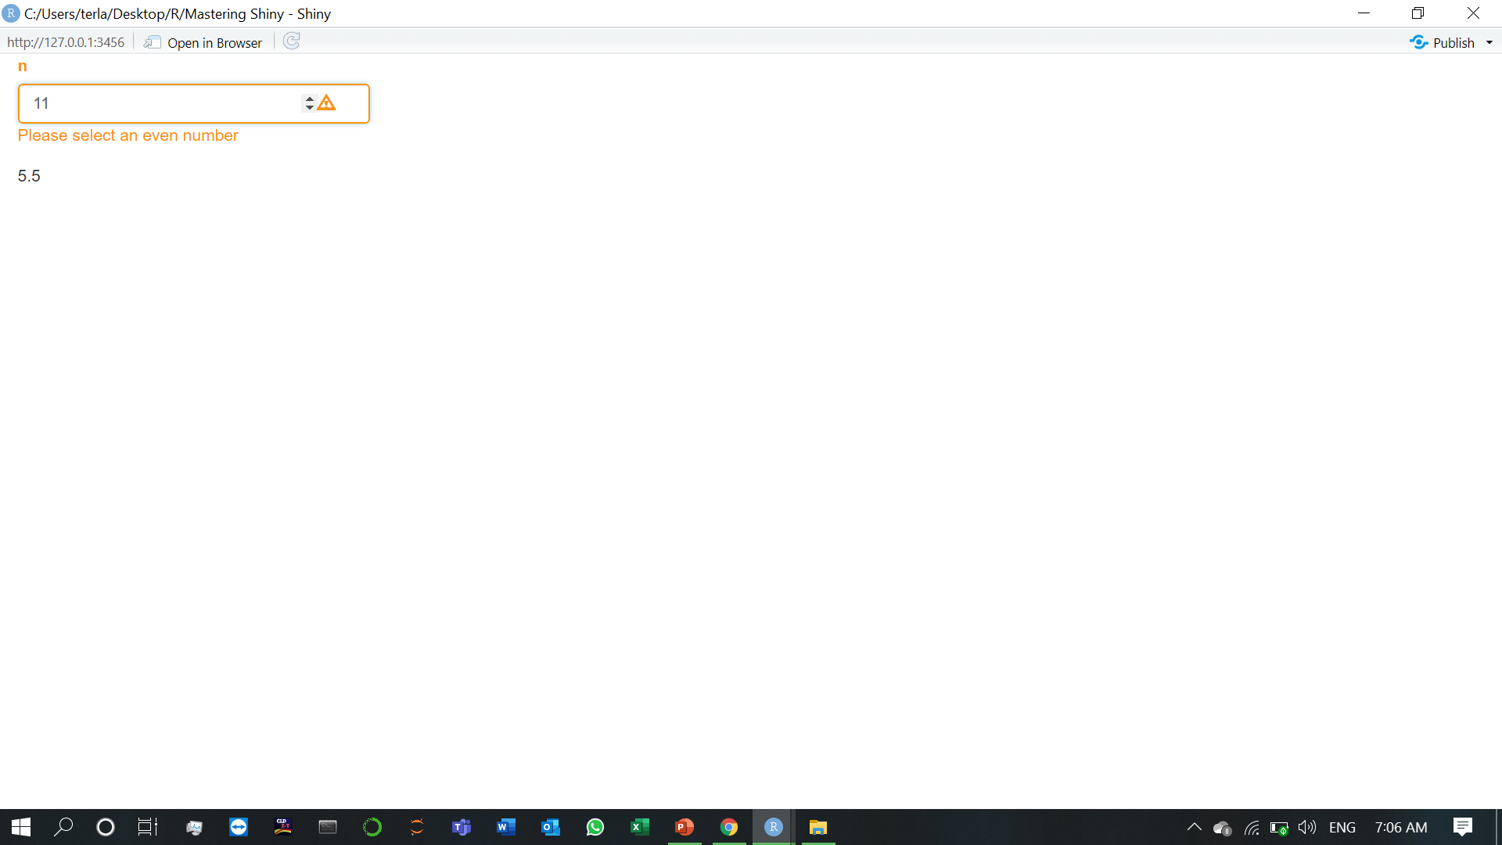

5.1) Validation (1.Validating input)
Then call one of the feedback functions in your server function. There are four variants: feedback(), feedbackWarning(), feedbackDanger(), and feedbackSuccess(). They all have three key arguments:
inputId, the id of the input where the feedback should be placed.
show, a logical determining whether or not to show the feedback.
text, the text to display.
These feedback functions also have color and icon arguments that you can use to further customise the appearance.

Slide 6
5.1) Validation (2.Pausing execution with req())
It’s easiest to understand req() by starting outside of validation. You may have noticed that when you start an app, the complete reactive graph is computed even before the user does anything. This works well when you can choose meaningful default values for your inputs. But that’s not always possible, and sometimes you want to wait until the user actually does something. This tends to crop up with three controls:
In textInput(), you’ve used value = "" and you don’t want to do anything until the user types something.
In selectInput(), you’ve provide an empty choice, "", and you don’t want to do anything until the user makes a selection.
In fileInput(), which has an empty result before the user has uploaded anything.
We need some way to “pause” reactives so that nothing happens until some condition is true. That’s the job of req(), which checks for required values before allowing a reactive producer to continue.
For example, consider the following app which will generate a greeting in English or Maori. If you run this app, you’ll see an error, because there’s no entry in the greetings vector that corresponds to the default choice of "".

Slide 7
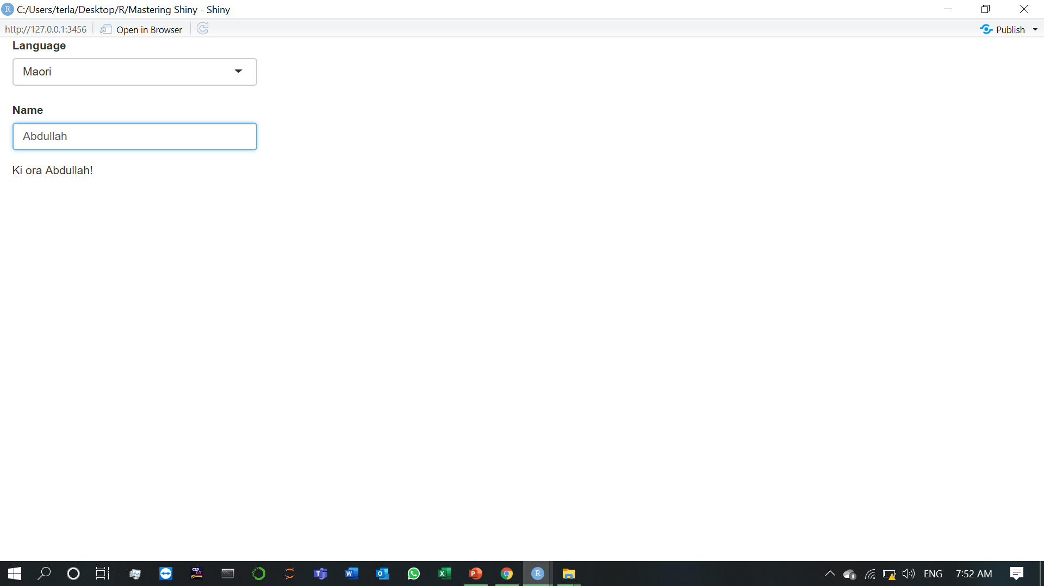

We can fix this problem by using req(), as below. Now nothing will be displayed until the user has suppled values for both language and name, as shown in Following figure.
req() is designed so that req(input$x) will only proceed if the user has supplied a value, regardless of the type of the input control. You can also use req() with your own logical statement if needed. For example, req(input$a > 0) will permit computation to proceed when a is greater than 0; this is typically the form you’ll use when performing validation, as we’ll see next.

Slide 8
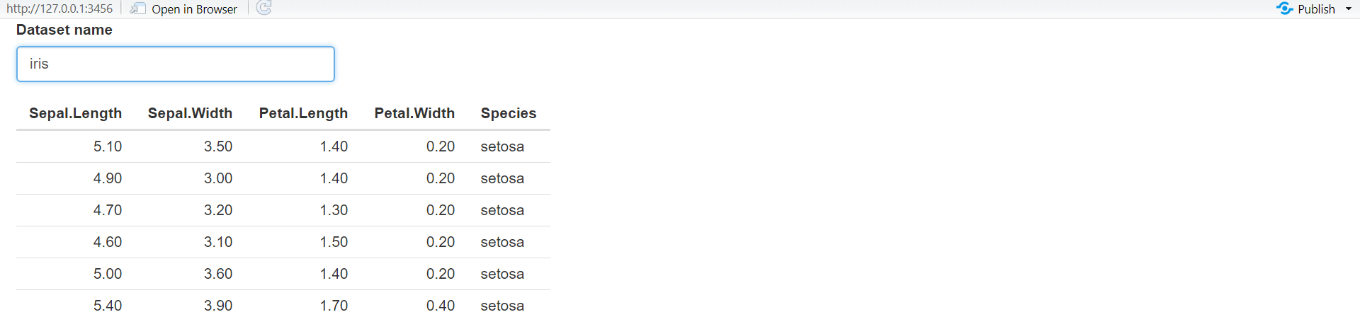
5.1) Validation (3.req() and validation)
We’re going to use req() in two ways:
We only want to proceed with computation if the user has entered a value so we do req(input$dataset).
Then we check to see if the supplied name actually exists. If it doesn’t, we display an error message, and then use req() to pause computation. Note the use of cancelOutput = TRUE: normally “pausing” a reactive will reset all downstream outputs; using cancelOutput = TRUE leaves them displaying the last good value. This is important for inputText() which may trigger an update while you’re in the middle of typing a name.

Slide 9
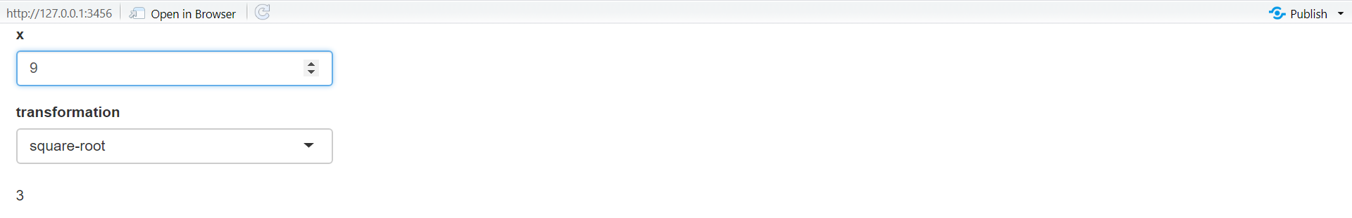
5.1) Validation (4.Validate output)
shinyFeedback is great when the problem is related to a single input. But sometimes the invalid state is a result of a combination of inputs. In this case it doesn’t really make sense to put the error next to an input (which one would you put it beside?) and instead it makes more sense to put it in the output.
You can do so with a tool built into shiny: validate(). When called inside a reactive or an output, validate(message) stops execution of the rest of the code and instead displays message in any downstream outputs. The following code shows a simple example where we don’t want to log or square-root negative values.

Slide 10
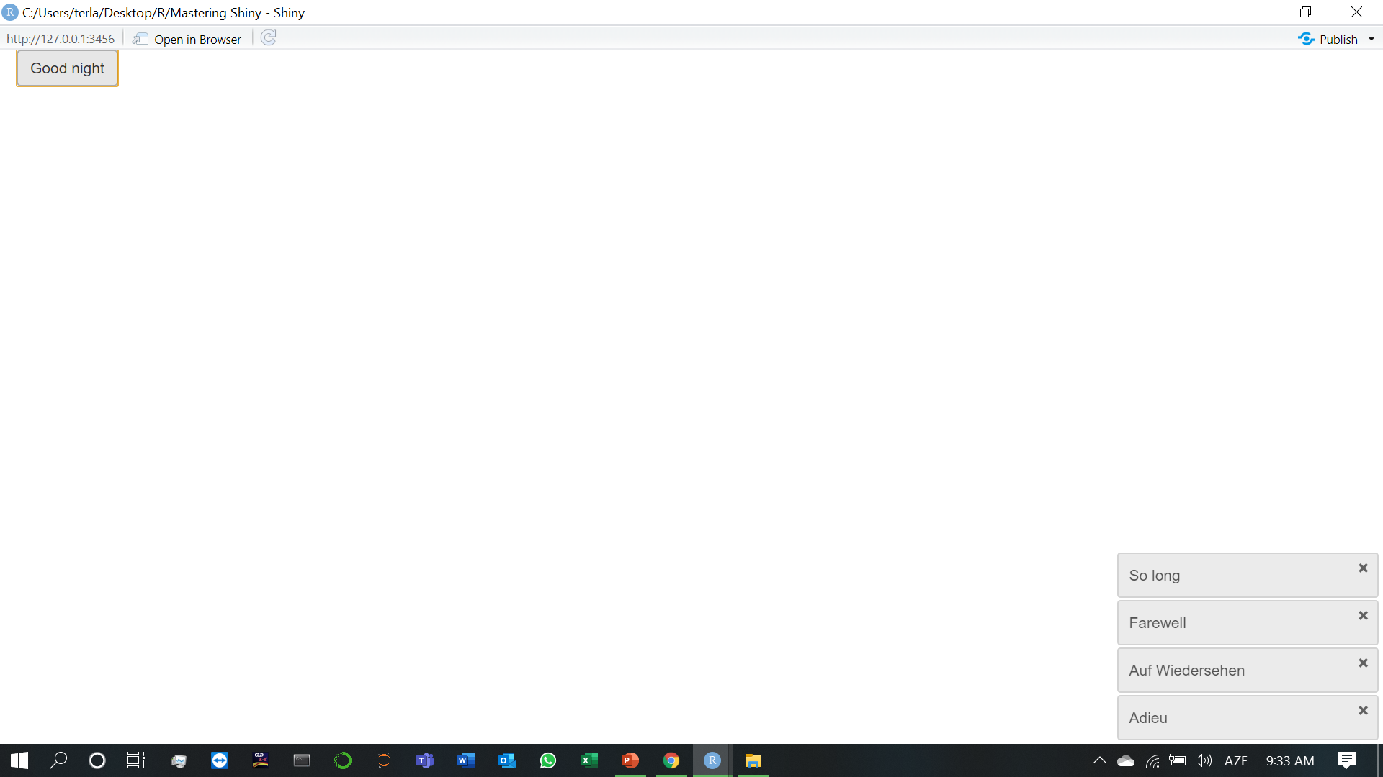
5.2)Notifications
If there isn’t a problem and you just want to let the user know what’s happening, then you want a notification. In Shiny, notifications are created with showNotification(), and stack in the bottom right of the page.

Slide 11
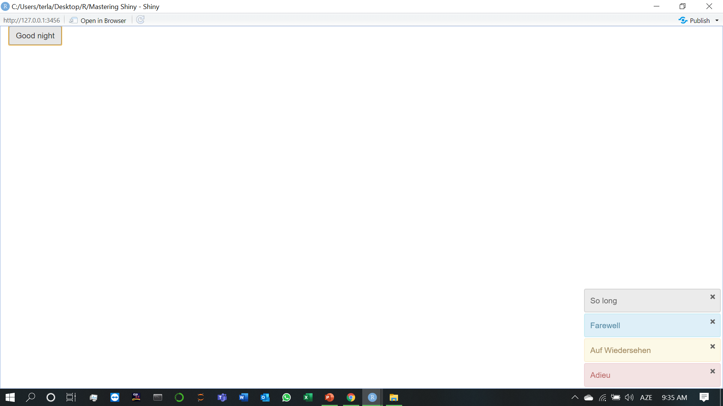
By default, the message will disappear after 5 seconds, which you can override by setting duration, or the user can dismiss it earlier by clicking the close button. If you want to make the notification more prominent, you can set the type argument to one of “message”, “warning”, or “error”.

Slide 12
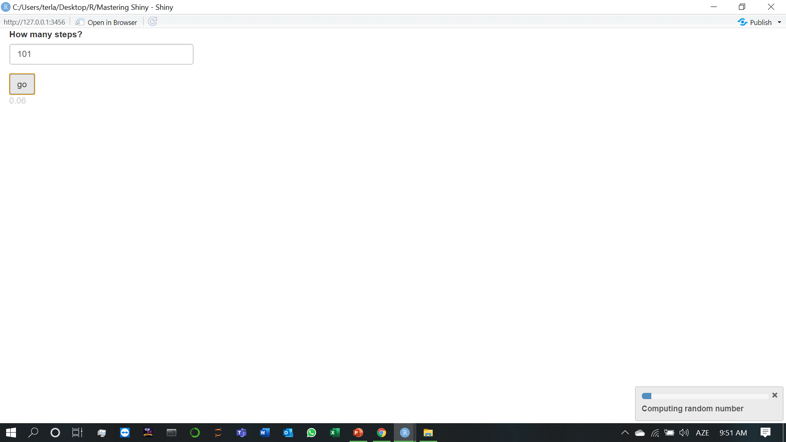
5.3)Progress bars
For long-running tasks, the best type of feedback is a progress bar. As well as telling you where you are in the process, it also helps you estimate how much longer it’s going to be: should you take a deep breath, go get a coffee, or come back tomorrow?
We are working on tools in the progress package so that packages like dplyr, readr, and vroom will generate progress bars that you can easily forward to Shiny. I’ll update this chapter when that approach is mature enough to use.
Here I’m using Sys.sleep() to simulate a long running operation; in your code this would be a moderately expensive operation.

Slide 13
5.4)Confirming and undoing
Sometimes an action is potentially dangerous, and you either want to make sure that the user really wants to do it, or you want to give them the ability to back out before it’s too late. The three techniques in this section lay out your basic options and give you some tips for how you might implement them in your app.
The simplest approach to protecting the user from accidentally performing a dangerous action is to require an explicit confirmation. The easiest way is to use a dialog box which forces the user to pick from one of a small set of actions. In Shiny, you create a dialog box with modalDialog(). This is called a “modal” dialog because it creates a new “mode” of interaction; you can’t interact with the main application until you have dealt with the dialog.
Imagine you have an Shiny app that deletes some files from a directory (or rows in a database etc). This is hard to undo so you want to make sure that the user is really sure. You could create a dialog box that requires an explicit confirmation as follows:

Slide 14
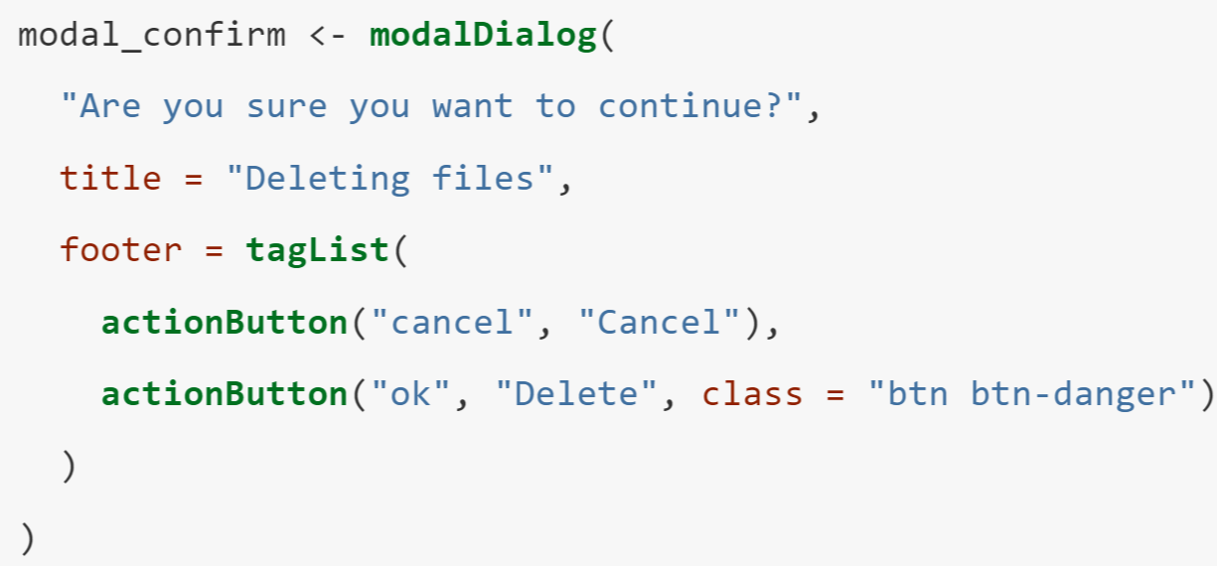
There are a few small, but important, details to consider when creating a dialog box:
What should you call the buttons? It’s best to be descriptive, so avoid yes/no or continue/cancel in favour of recaptiulating the key verb.
How should you order the buttons? Do you put cancel first (like the Mac), or continue first (like Windows)? Your best option is to mirror the platform that you think most people will be using.
Can you make the dangerous option more obvious? Here I’ve used class = "btn btn-danger" to style the button prominently.

Slide 15
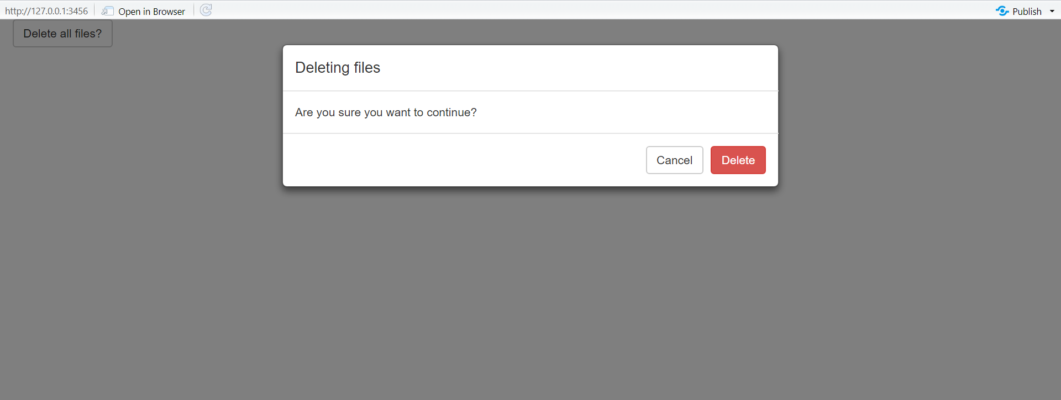
There are two new ideas in the server():
We use showModal() and removeModal() to show and hide the dialog.
We observe events generated by the UI from modal_confirm. These objects aren’t created statically in the ui, but are instead dynamically added in the server() by showModal().

Slide 16
6)Uploads and downloads
Transferring files to and from the user is a common feature of apps. You can use it to upload data for analysis, or download the results as a dataset or as a report. This chapter shows the UI and server components that you’ll need to transfer files in and out of your app.
We’ll start by discussing file uploads, showing you the basic UI and server components, and then showing how they fit together in a simple app.

Slide 17
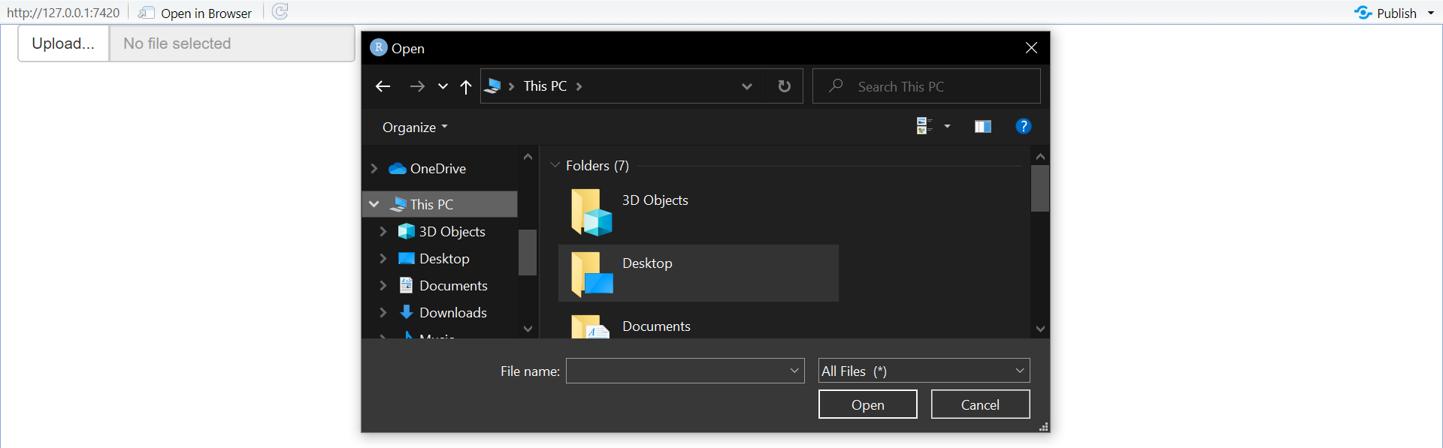
6.1)Upload (1.UI & Server)
Note my use of the label and buttonLabel arguments to mildly customise the appearance, and use of multiple = TRUE to allow the user to upload multiple files.

Slide 18
6.1)Upload (2.Uploading data)
If the user is uploading a dataset, there are two details that you need to be aware of:
input$file is initialised to NULL on page load, so you’ll need req(input$file) to make sure your code waits until the first file is uploaded.
The accept argument allows you to limit the possible inputs. The easiest way is to supply a character vector of file extensions, like accept = ".csv". But the accept argument is only a suggestion to the browser, and is not always enforced. The easiest way to get the file extension in R is tools::file_ext(), but note that it strips the leading . .
Putting all these ideas together gives us the following app where you can upload a .csv or .tsv file and see the first n rows:

Slide 19

Note that since multiple = FALSE (the default), input$file will be a single row data frame, and input$file$name and input$file$datapath will be a length-1 character vectors.
Next, we’ll look at file downloads, showing you the basic UI and server components, then demonstrating how you might use them to allow the user to download data or reports.

Slide 20
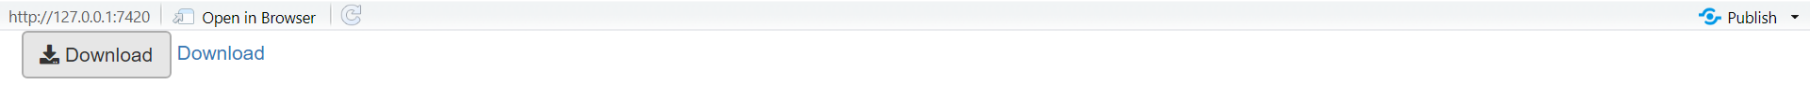
6.2)Download (1.Basics)
The UI is straightforward: use either downloadButton(id) or downloadLink(id) to give the user something to click to download a file.
You can customise their appearance using the same class and icon arguments as for actionButtons(). Unlike other outputs, downloadButton() is not paired with a render function. Instead, you use downloadHandler().
downloadHandler() has two arguments, both functions:
filename should be a function with no arguments that returns a file name (as a string). The job of this function is to create the name that will be shown to the user in the download dialog box.
content should be a function with one argument, file, which is the path to save the file. The job of this function is to save the file in a place that Shiny knows about, so it can then send it to the user.

Slide 21
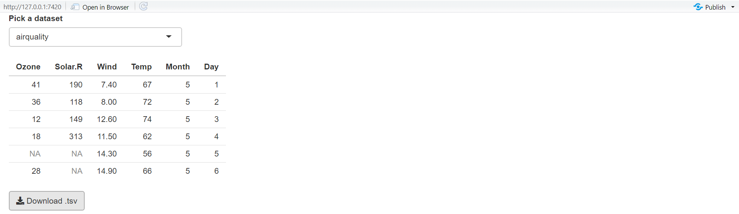
6.2)Download (2.Downloading data)
This app shows off the basics of data download by allowing you to download any dataset in the datasets package as a tab separated file.
Note the use of validate() to only allow the user to download datasets that are data frames. A better approach would be to pre-filter the list, but this lets you see another application of validate().

Slide 22
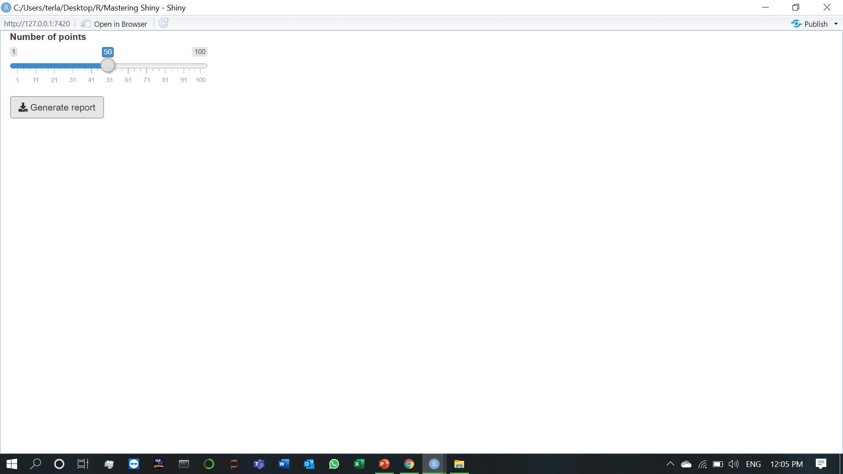
6.2)Download (3.Downloading reports)
Here’s a simple example adapted from https://shiny.rstudio.com/articles/generating-reports.html, which describes this technique in more detail. The key idea is to call rmarkdown::render() from the content argument of downloadHander(). If you want to produce other output formats, just change the output format in the .Rmd, and make sure to update the extension (e.g. to .pdf).

Slide 23
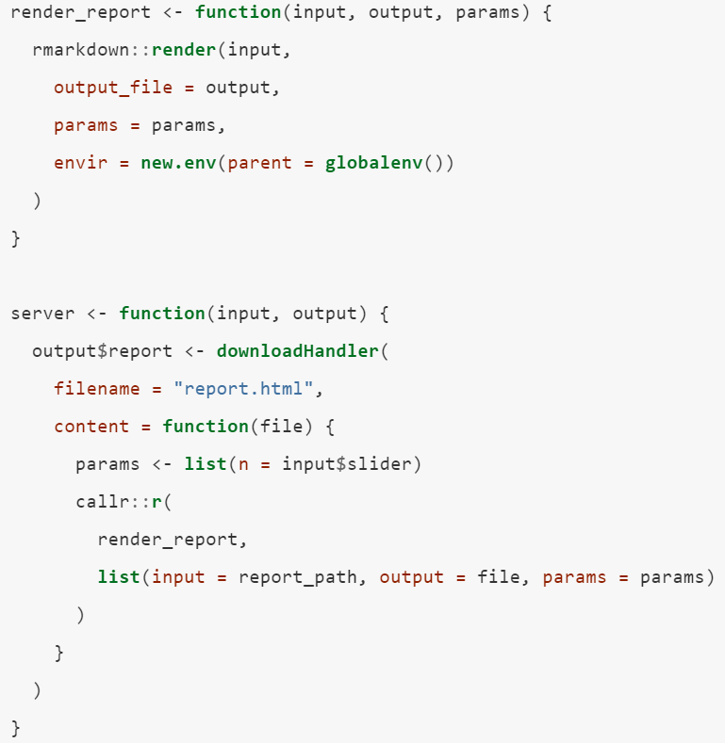
By default, RMarkdown will render the report in the current process, which means that it will inherit many settings from the Shiny app (like loaded packages, options, etc). For greater robustness, I recommend running render() in a separate R session using the callr package:

Slide 24
7)Dynamic UI
So far, we’ve seen a clean separation between the user interface and the server function: the user interface is defined statically when the app is launched so it can’t respond to anything that happens in the app. In this chapter, you’ll learn how to create dynamic user interfaces, changing the UI using code run in the server function.
There are three key techniques for creating dynamic user interfaces:
Using the update family of functions to modify parameters of input controls.
Using tabsetPanel() to conditionally show and hide parts of the user interface.
Using uiOutput() and renderUI() to generate selected parts of the user interface with code.
We’ll begin with a simple technique that allows you to modify an input after it has been created: the update family of functions. Every input control, e.g. textInput(), is paired with an update function, e.g. updateTextInput(), that allows you to modify the control after it has been created.

Slide 25
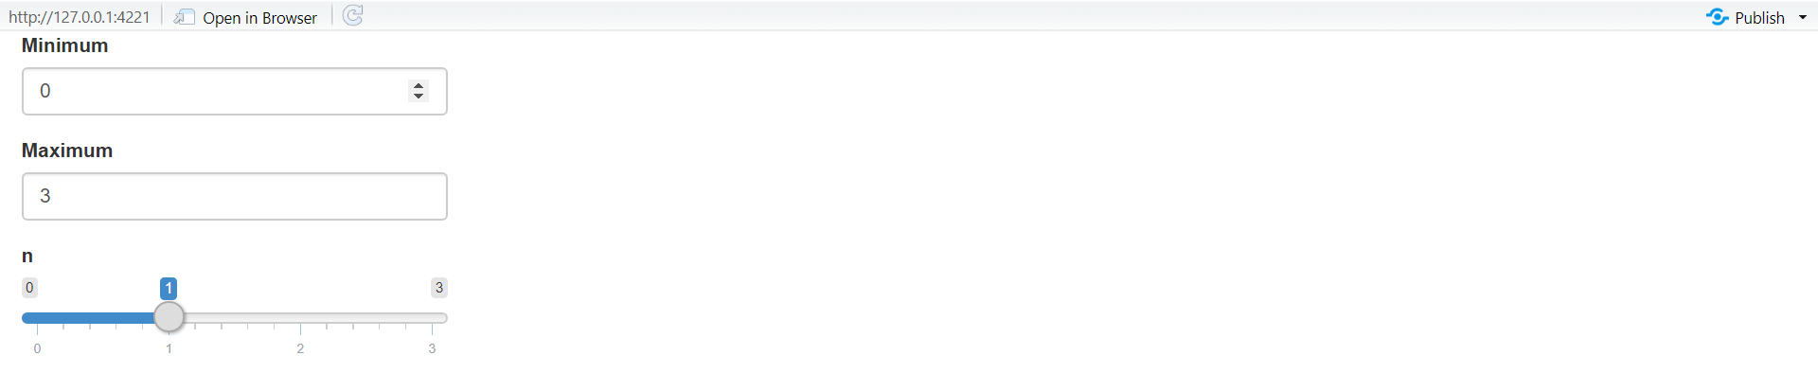
7.1)Updating inputs
The app has two inputs that control the range (the min and max) of another input, a slider. The key idea is to use observeEvent() to trigger updateSliderInput() whenever the min or max inputs change.
The update functions look a little different to other Shiny functions: they all take the current session as the first argument, and the name of the input (as a string) as the second. The remaining arguments match the arguments to the input constructor.
To help you get the hang of the update functions, I’ll show a couple more simple examples, then we’ll dive into a more complicated case study using hierarchical select boxes, and finish off by discussing the problem of circular references.

Slide 26
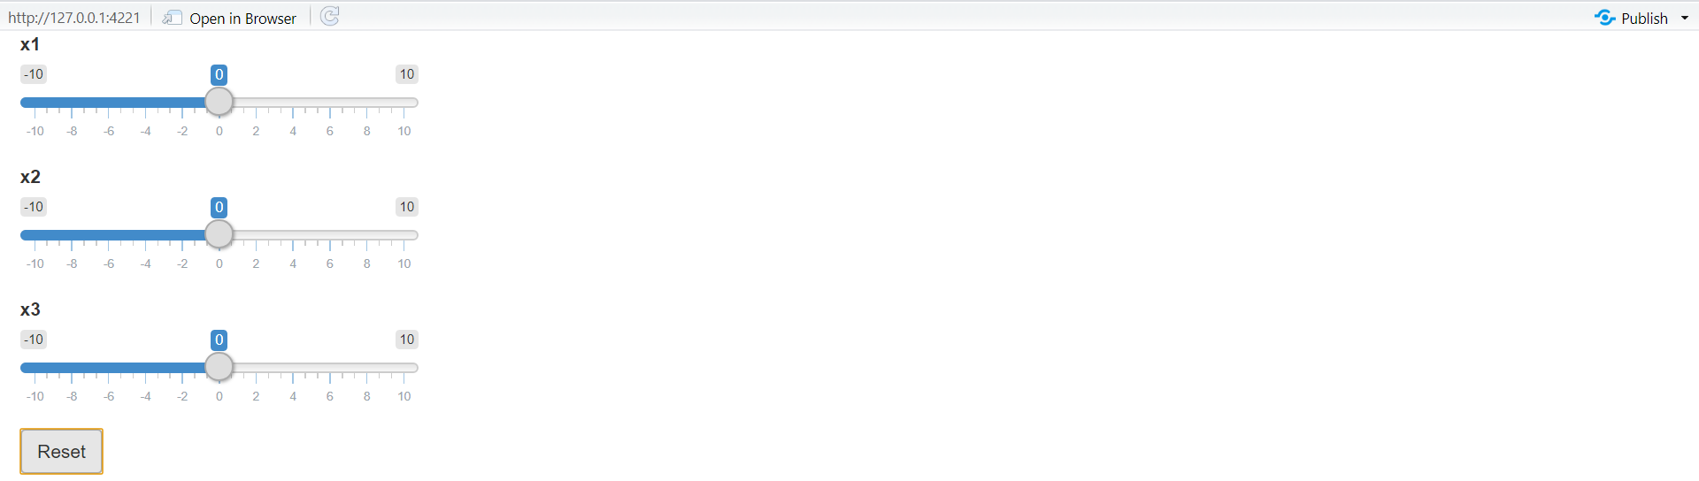
7.1)Updating inputs (1.Simple uses)
The simplest uses of the update functions are to provide small conveniences for the user. For example, maybe you want to make it easy to reset parameters back to their initial value. The following snippet shows how you might combine an actionButton(), observeEvent() and updateSliderInput().

Slide 27
7.1)Updating inputs (2.Hierarchical select boxes)
A more complicated, but particularly useful, application of the update functions is to allow interactive drill down across multiple categories. I’ll illustrate their usage with some imaginary data for a sales dashboard that comes from https://www.kaggle.com/kyanyoga/sample-sales-data.
For this demo, I’m going to focus on a natural hierarchy in the data:
Each territory contains customers.
Each customer has multiple orders.
Each order contains rows.
I want to create a user interface where you can:
Select a territory to see all customers.
Select a customer to see all orders.
Select an order to see the underlying rows.

Slide 28
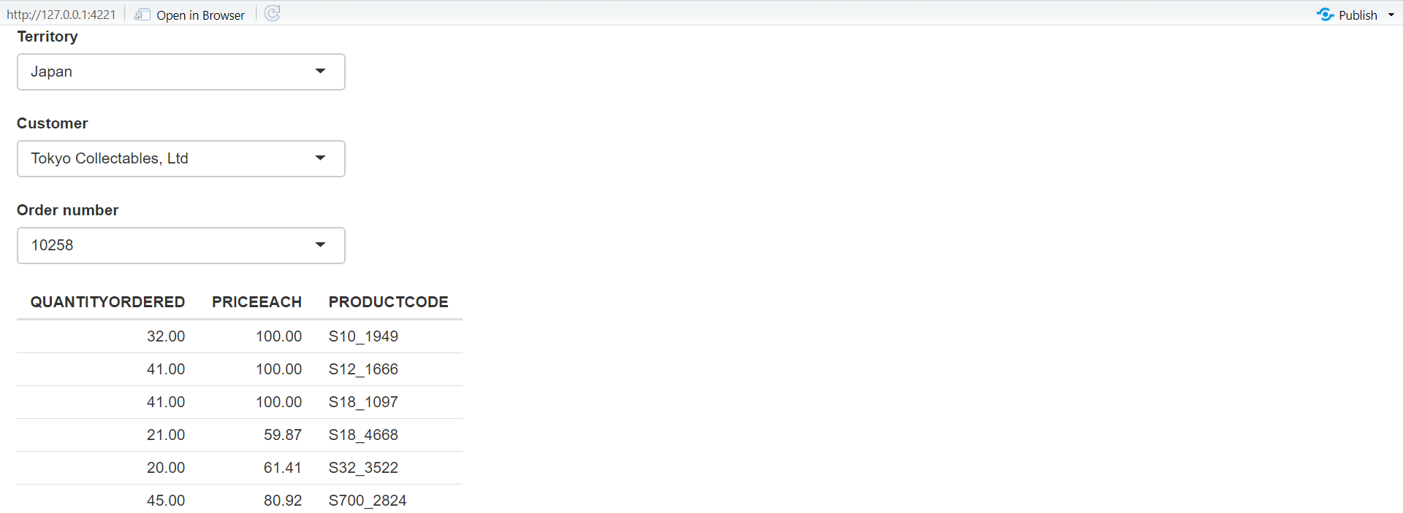
The essence of the UI is simple: I’ll create three select boxes and one output table. The choices for the customername and ordernumber select boxes will be dynamically generated, so I set choices = NULL.

Slide 29
In the server function, I work top-down:
I create a reactive, territory(), that contains the rows from sales that match the selected territory.
Whenever territory() changes, I update the list of choices in the input$customername select box.
I create another reactive, customer(), that contains the rows from territory() that match the selected customer.
Whenever customer() changes, I update the list of choices in the input$ordernumber select box.
I display the selected orders in output$data.

Slide 30
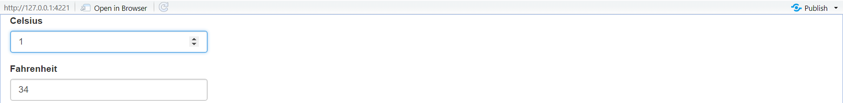
7.1)Updating inputs (3.Inter-related inputs)
If you play around with this app, you’ll notice that it mostly works, but you might notice that it’ll sometimes trigger multiple changes. For example:
Set 120 F, then click the down arrow.
F changes to 119, and C is updated to 48.
48 C converts to 118 F, so F changes again to 118.
Fortunately 118 F is still 48 C, so the updates stop there.
There’s no way around this problem because you have one idea (the temperature) with two expressions in the app (Celsius and Fahrenheit). Here we are lucky that cycle quickly converges to a value that satisfies both constraints. In general, you are better off avoiding these situations, unless you are willing to very carefully analyse the convergence properties of the underlying dynamic system that you’ve created.

Slide 31
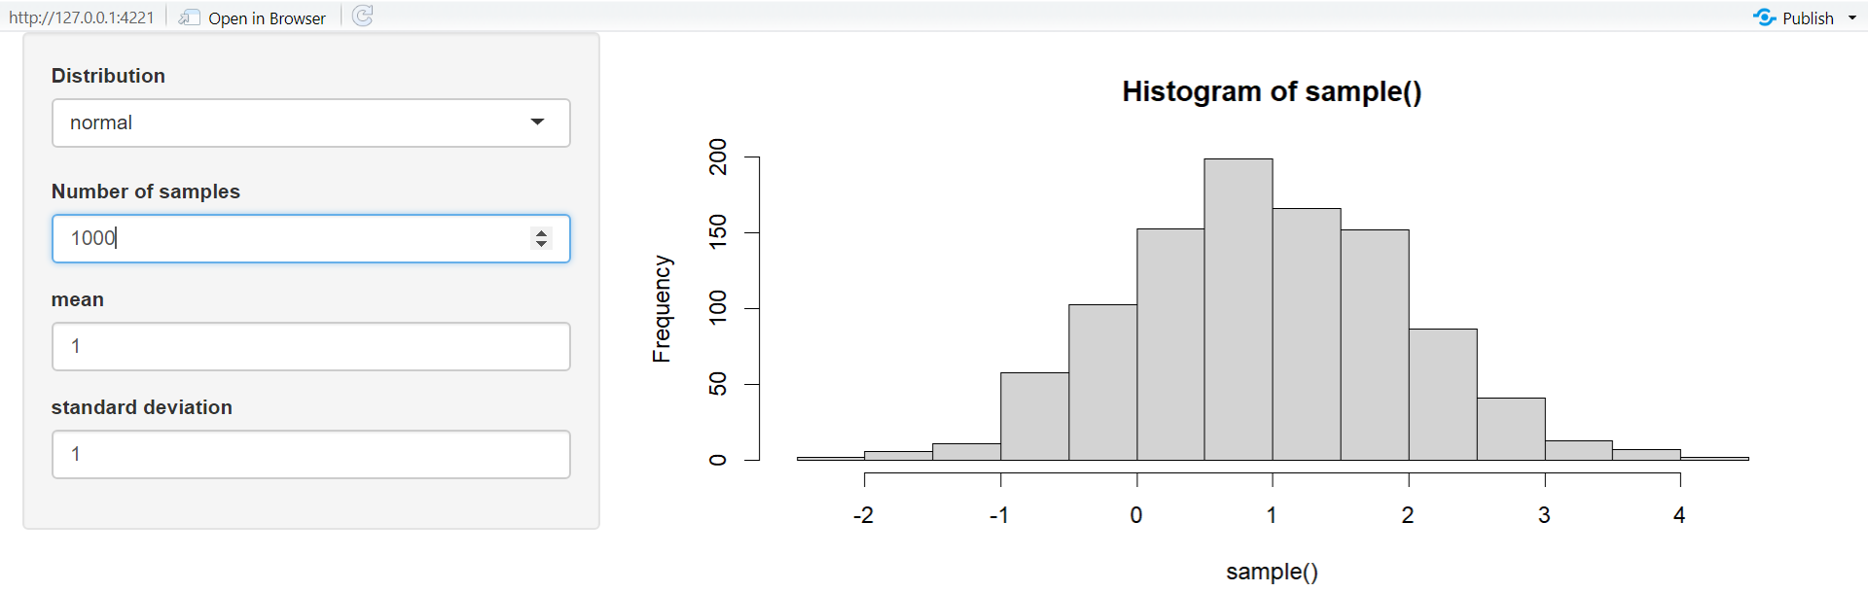
7.2)Dynamic visibility (1.Inter-related inputs)

Slide 32
Imagine that you want an app that allows the user to simulate from the normal, uniform, and exponential distributions. Each distribution has different parameters, so we’ll need some way to show different controls for different distributions. Here, I’ll put the unique user interface for each distribution in its own tabPanel(), and then arrange the three tabs into a tabsetPanel().
Note that I’ve carefully matched the choices in input$dist to the names of the tab panels. That makes it easy to write the observeEvent() code below that automatically switches controls when the distribution changes. The rest of the app uses techniques that you’re already familiar with.

Slide 33
7.3)Creating UI with code
Sometimes none of the techniques described above gives you the level of dynamism that you need. There’s one last technique that gives you the ability to create any controls (both inputs and outputs) with code in the server function. You’ve always created your UI with code; this technique gives you the ability to re-generate the user interface while the app is running, not just define it when the app starts.
This technique has two components:
You use uiOutput() to insert a placeholder in your user interface. This code is run when your app launches and it leaves a “hole” that your server code can later fill in.
You use renderUI() to fill in the placeholder with UI generated in the server function.

Slide 34
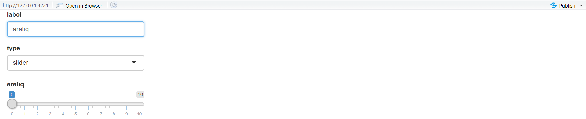
Here’s a simple example to illustrate the basic idea. It dynamically creates a different type of input control depending on an input.
If you run this code yourself, you’ll notice that it takes a fraction of a second to appear after the app loads. That’s because it’s reactive: the app must load, trigger a reactive event, which calls the server function, yielding HTML to insert into the page. This is one of the downsides of renderUI(); relying on it too much can create a laggy UI.

Slide 35
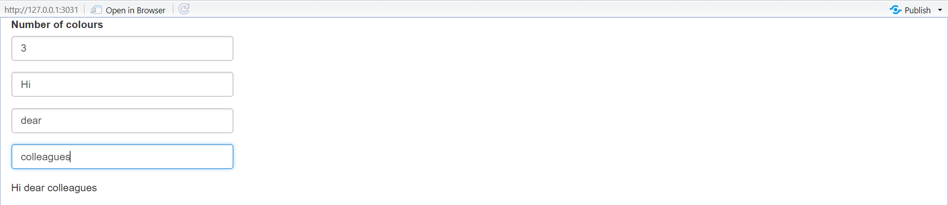
7.3)Creating UI with code (1.Multiple controls)
An important use of renderUI() is when you need to create an arbitrary number of controls. For example, imagine you’d like the user to be able to supply their own palette of colours. They’ll first specify how many colours they want, and then supply a value for each colour. The ui is pretty simple: we have a numericInput() that controls the number of inputs, a uiOutput() where the generated text boxes will go, and a textOutput() that demonstrates that we’ve plumbed everything together correctly.

Slide 36
There are three key ideas in the server function:
I create a reactive, col_names(), that generates a character vector giving the name of each of the colour inputs I’m about to generate.
I create the text boxes by using map() to create one textInput() for input in col_names(). output$col <- renderUI() inserts these textboxes in the UI placeholder that I created earlier.
To generate the output, I need to use use a new trick. So far we’ve always accessed the components of input with $, e.g. input$col1. But here we have the input names in a character vector, like var <- "col1". $ no longer works in this scenario, so we need to swich to [[, i.e. input[[var]]. I use map_chr() to collect all values into a character vector, and display that in output$palette.

Slide 37
7.3)Creating UI with code (2.Dynamic filtering)
To finish off the chapter, I’m going to create an app that lets you dynamically filter any data frame. Each numeric variable will get a range slider and each factor variable will get a multi-select, so (e.g.) if a data frame has three numeric variables and two factors, the app will have three sliders and two select boxes.
I’ll start with a function that creates the UI for a single variable. It’ll return a range slider for numeric inputs, a multi-select for factor inputs, and NULL (nothing) for all other types.
And then I’ll write the server side equivalent of this function: it takes the variable and value of the input control, and returns a logical vector saying whether or not to include each observation. I return a logical vector here because it’ll make it easy to combine the results from multiple columns.
I can then use these functions “by hand” to generate a simple filtering UI for the iris dataset:

Slide 38
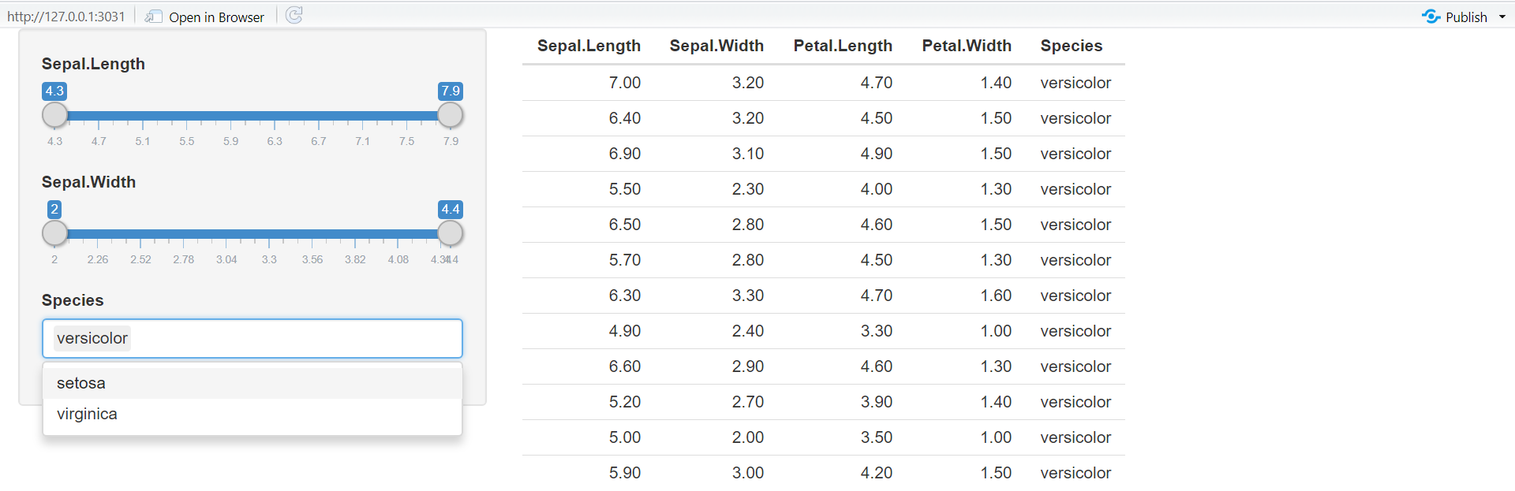
You might notice that I got sick of copying and pasting so the app only works with three columns. I can make it work with all the columns by using a little functional programming:
In ui use map() to generate one control for each variable.
In server(), I use map() to generate the selection vector for each variable. Then I use reduce() to take the logical vector for each variable and combine into a single logical vector by & -ing each vector together.

Slide 39
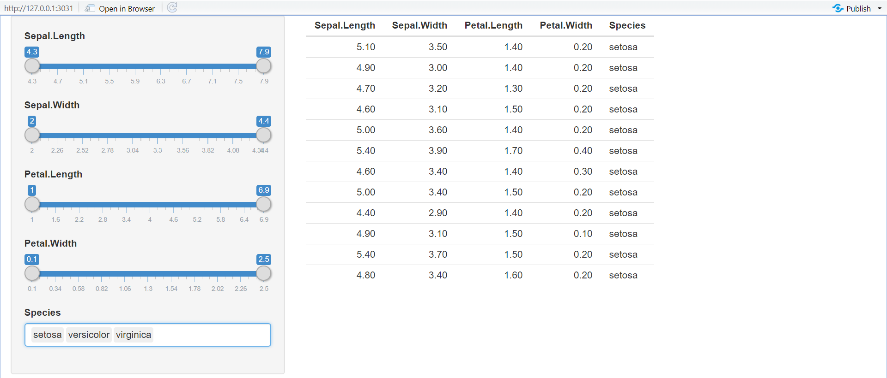
From there, it’s a simple generalisation to work with any data frame. Here I’ll illustrate it using the data frames in the datasets package, but you can easily imagine how you might extend this to user uploaded data. See the result in Following figure.

Slide 40
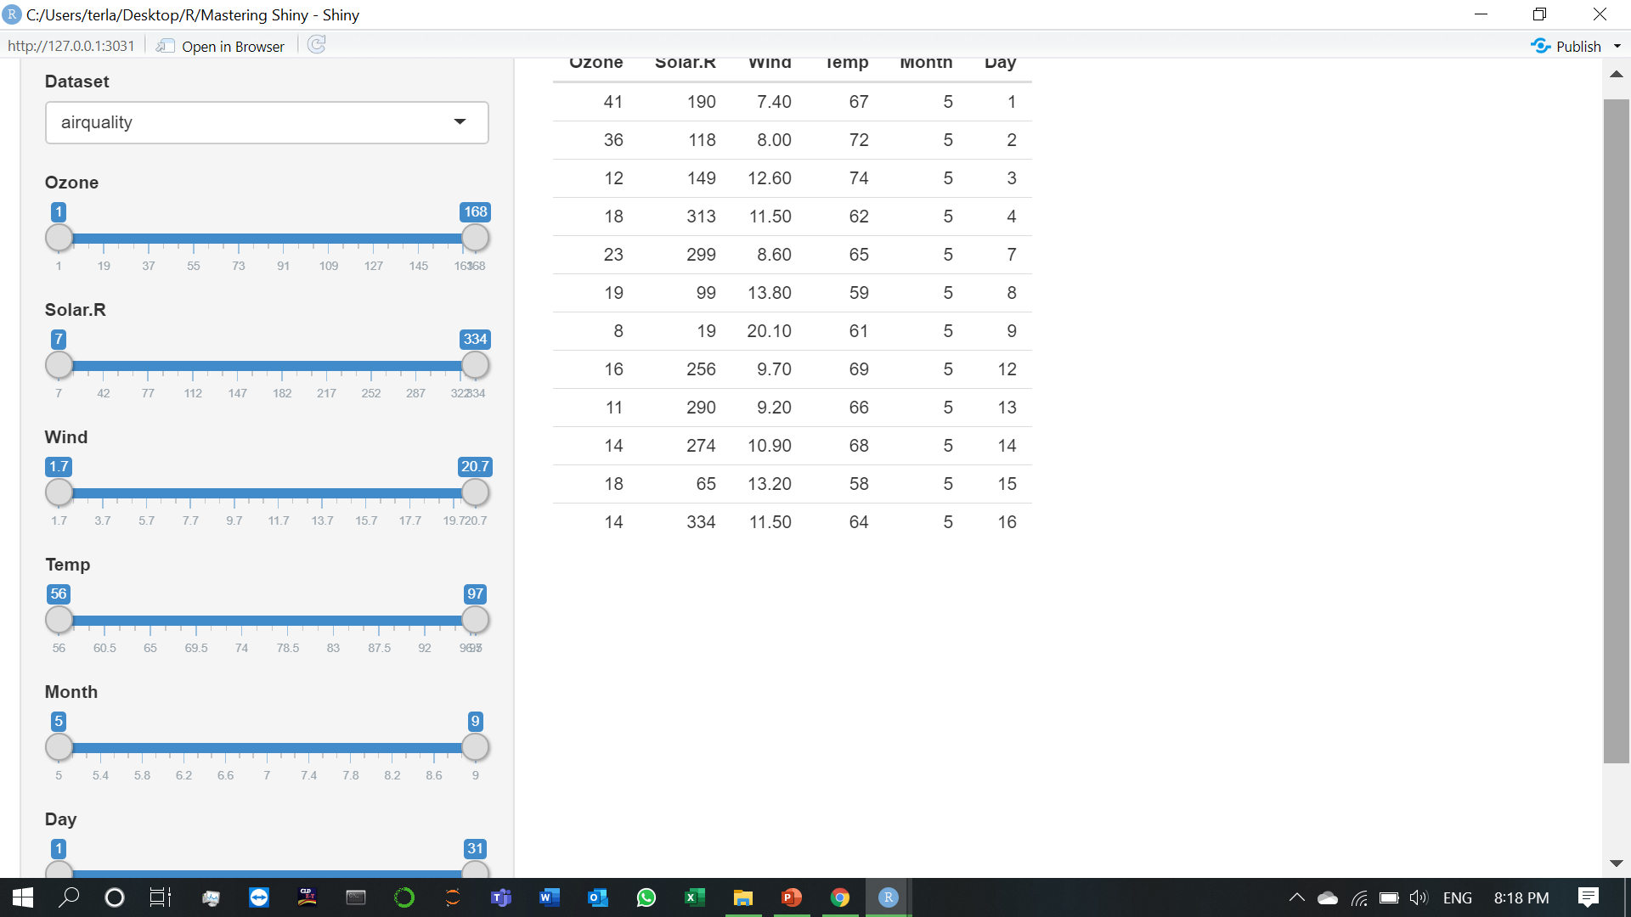

Slide 41
8)Tidy evaluation
If you are using Shiny with the tidyverse, you will almost certainly encounter the challenge of programming with tidy evaluation. Tidy evaluation is a tool that the tidyverse uses to facilitate fluid interactive data exploration, but it comes with a cost: it’s hard to refer to variables indirectly, and hence harder to program with.
This chapter will show you how to use Shiny with the two most common forms of tidy evaluation:
Data-masking allows you to refer to variables within a data frame without repeating the name of the data frame. For example, this code can use the x, z, carat, and price variables from the diamonds dataset because filter() and aes() use data-masking.
Tidy-selection allows you to concisely select variables by their position, name, or value. For example, the following code selects all variables from iris that start with “sepal”, and all numeric variables from diamonds.

Slide 42
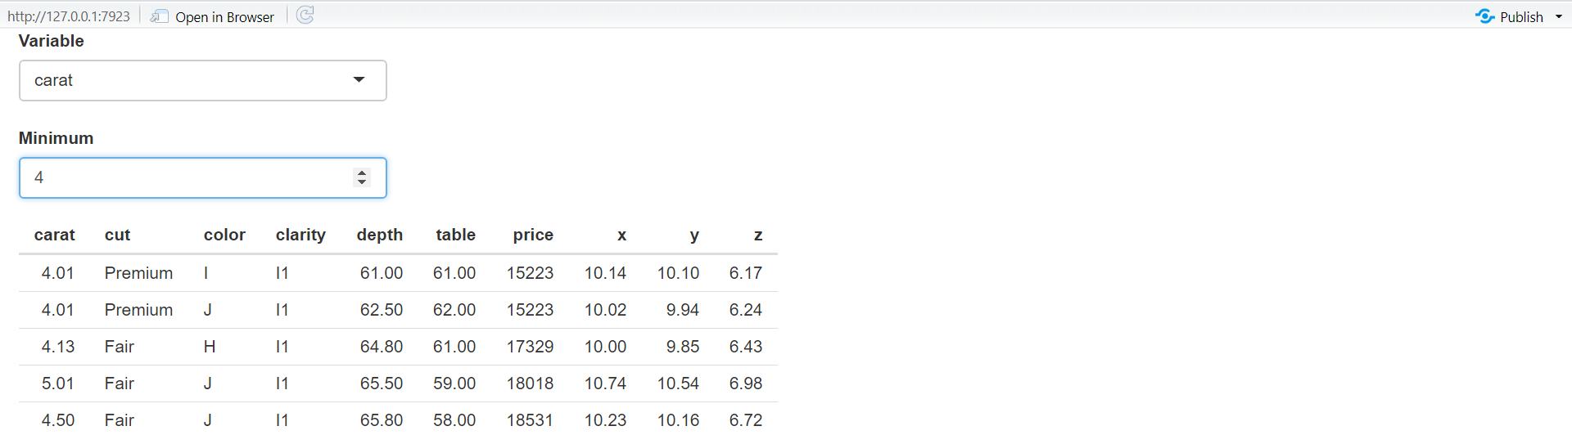
8.1)Data-masking (1.Indirection)
Note that if we didn’t use .data, as below, the app will not work correctly, but also won’t generate an error message. That’s because input$var will be a string like "carat" and "carat" > 0 is valid R expression that evaluates to TRUE, selecting all rows.
Let’s apply this idea to a dynamic plot where we allow the user to create a scatterplot by selecting the variables to appear on the x and y axes:

Slide 43
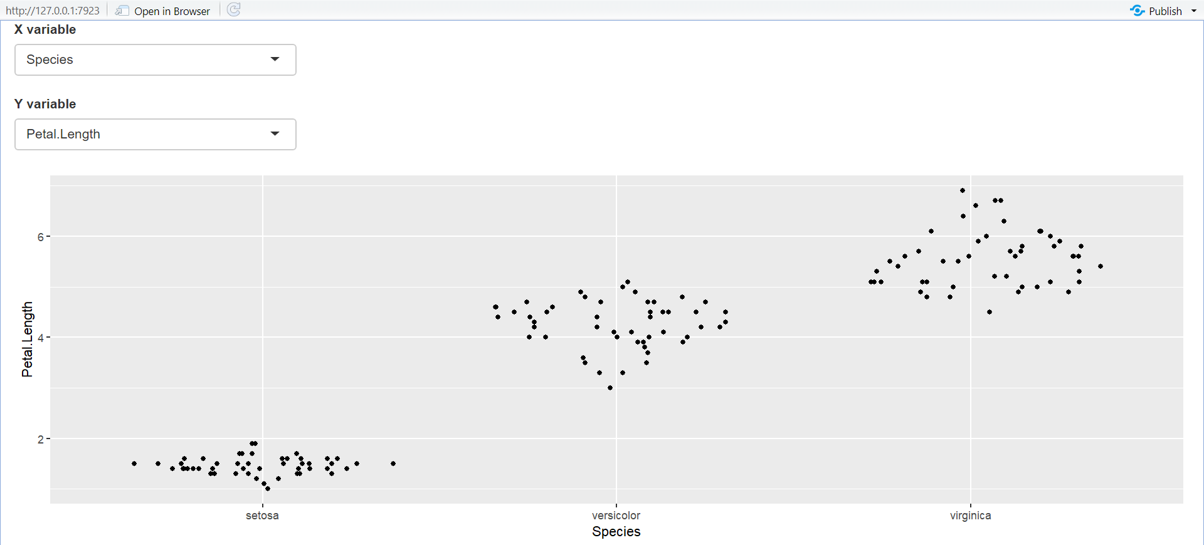
8.1)Data-masking (2.Example: ggplot2)
Here I’ve used ggforce::position_auto() so that geom_point() works nicely regardless of whether the x and y variables are continuous or discrete. Alternatively, we could allow the user to pick the geom. The following app uses a switch() statement to genereate a reactive geom that is later added to the plot.

Slide 44
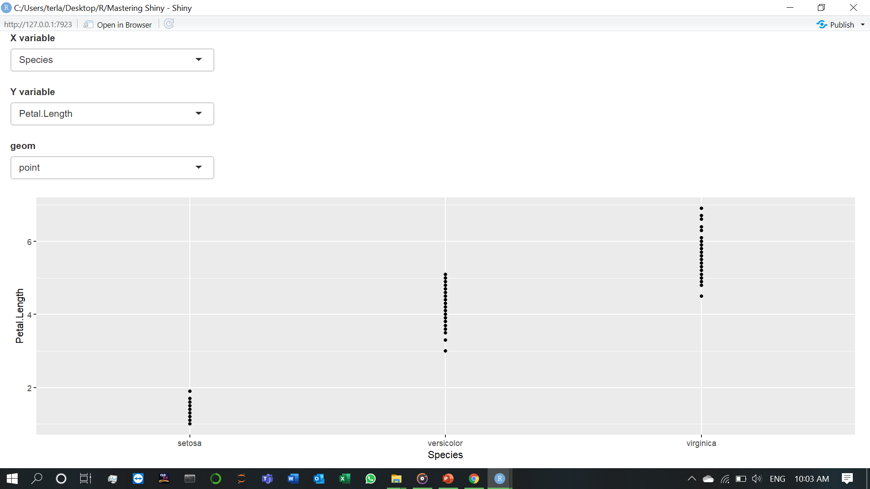
This is one of the challenges of programming with user selected variables: your code has to become more complicated to handle all the cases the user might generate.

Slide 45
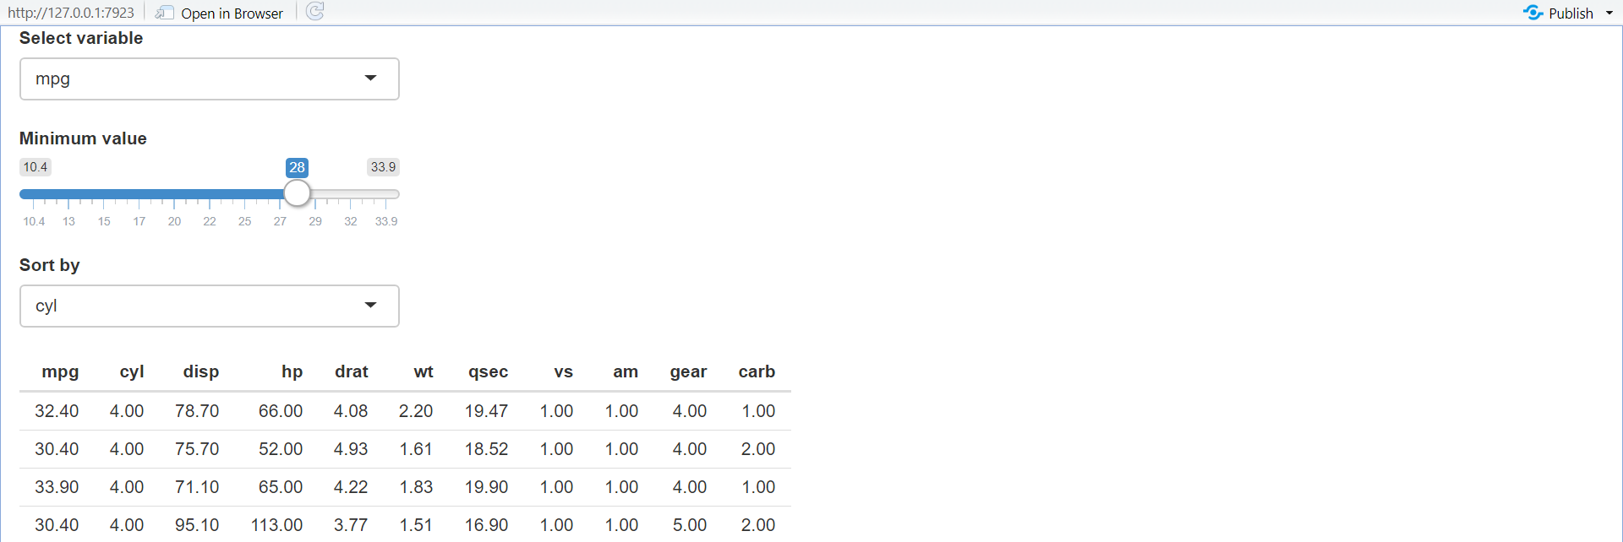
8.1)Data-masking (3.Example: dplyr)
The same technique also works for dplyr. The following app extends the previous simple example to allow you to choose a variable to filter, a minimum value to select, and a variable to sort by.
Most other problems can be solved by combining .data with your existing programming skills. For example, what if you wanted to conditionally sort in either ascending or descending order?

Slide 46
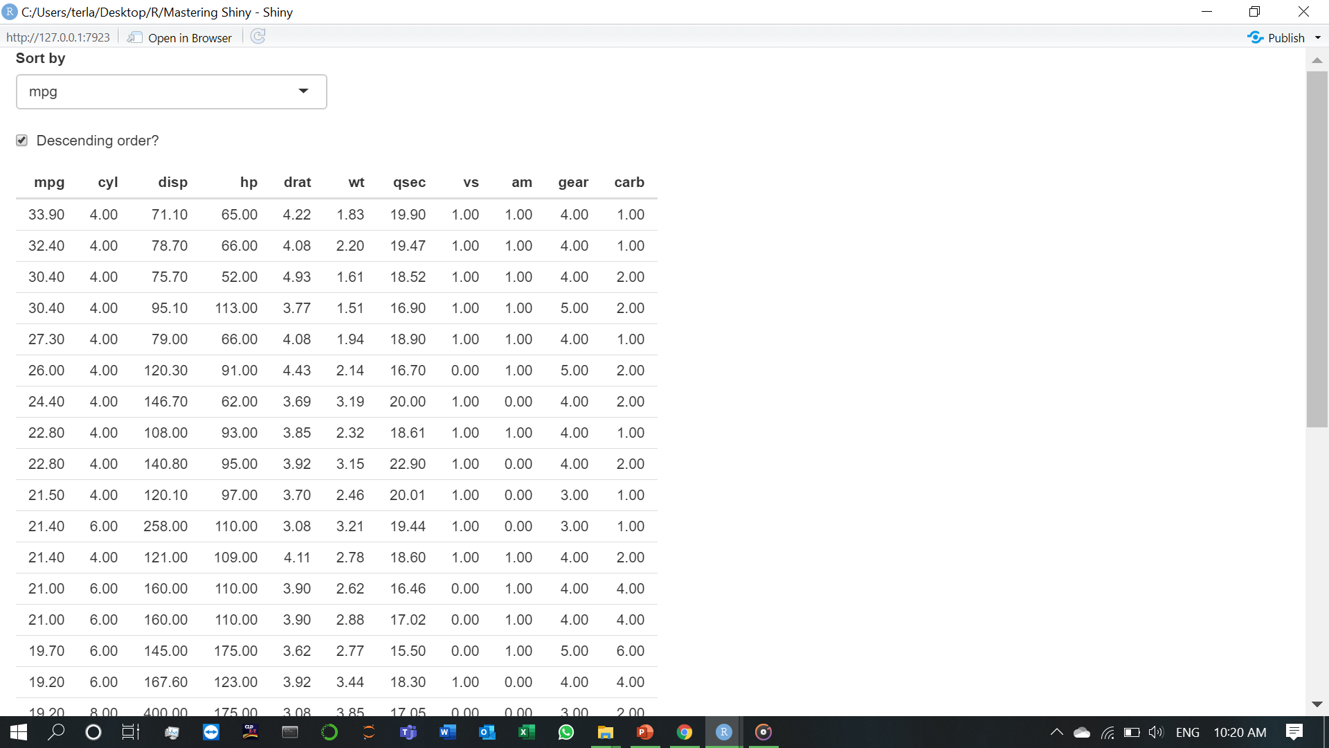

Slide 47
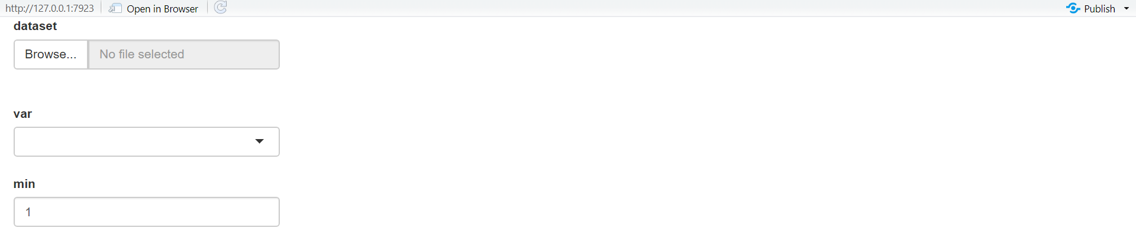
8.1)Data-masking (4.User supplied data)
Most other problemsBefore we move on to talk about tidy-selection, there’s one last topic we need to discuss: user supplied data. Take the following app: it allows the user to upload a tsv file, then select a variable and filter by it. It will work for the vast majority of inputs that you might try it with:

Slide 48
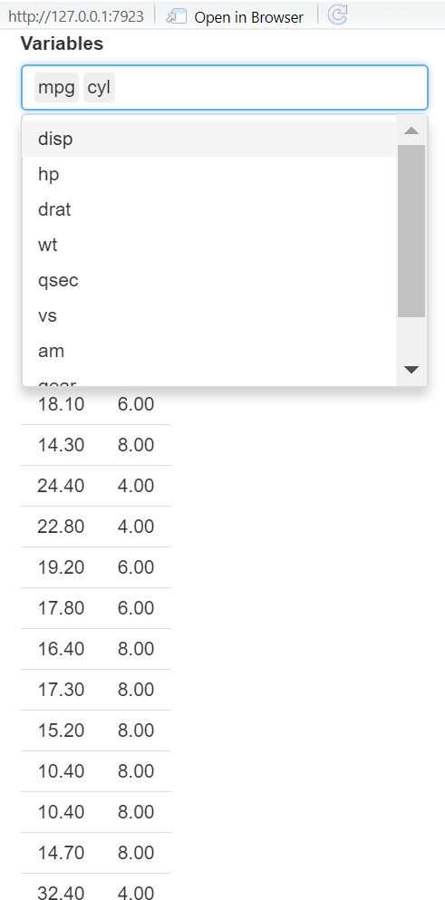
8.2)Tidy-selection
To refer to variables indirectly use any_of() or all_of(): both expect a character vector env-variable containing the names of data-variables. The only difference is what happens if you supply a variable name that doesn’t exist in the input: all_of() will throw an error, while any_of() will silently ignore it.
For example, the following app lets the user select any number of variables using a multi-select input, along with all_of():

